Slide 1


INFO SESSION
Ganawend'Zoyang
“taking care of our own”
Social Services Department
(OW) Program & More
September 2014
Notes:
This presentation is geared to helping you will leave here with a clearer understanding of Ontario Works – the application process, eligibility criteria, the rates, and benefits, and rights and responsibilities between our office and our clients.

Slide 2
Section Slide #
Ontario Works – Full Delivery OW Program – Overview 3-5
Ontario Works – Application Process 6-11
Ontario Works – Entitlements 12-14
Ontario Works – Benefits 15-18
Ontario Works – Overpayments 19
Ontario Works – Employment Assistance 20-45
Ontario Works – Participation Agreements 23-38
Ontario Works – Employment and Participation Benefits 39-45
Ontario Works – Eligibility Issues – Compliance 46-49
Friends of Social Services Department 50

Slide 3
“Ganawend'Zoyang”
The OW Program supports people who are in temporary financial need find full time sustainable employment and achieve self-reliance through the delivery of effective, integrated employment services and financial assistance.
Notes:
There are fifty slides here – I will breeze through some areas so as to allow more time for discussion in other areas of concern.

Slide 4
“Ganawend'Zoyang”
Ontario Works is a Full Delivery Program providing Financial & Employment Assistance and is the doorway to other supports:
    Discretionary Benefits
    Transitional Support Fund
    Food Security Programs
    Homemakers Program, and
    Other local/regional services and programs
    Note: More info related to these in development

Slide 5
Ontario Works provides two types of assistance:
Financial Assistance
Income assistance for basic needs and shelter
Benefits prescribed by regulations
Emergency assistance
Temporary Care assistance
Employment Assistance
Partnered/linked with local training providers and employers to provide short–term customized training that leads to sustainable employment
YES Program, Superior Training and PARO
ILC
Red Rock Indian Band

Slide 6

Who can apply?
Anyone can apply for assistance.
Generally, eligible applicants are:
needing assistance while unemployed or part-time employed
raising grandchildren or have taken on the responsibility of caring for a child
attending school or training course(s)
in a crisis or emergency situation
Note: For our local office, be a resident of Lake Helen Reserve
Upon completion of application, the Administrator determines eligibility, provides a written decision to applicant along with an appeal process.

Slide 7

Steps to Applying for OW
  An Advance List is available from the Social Services Department.
Call our office, and we will:
start your application over the phone,
identify missing information required to complete the verification of your information, and
schedule an appointment
During your appointment we will:
print , review, and sign the documents.
You may bring anyone with you to appointments.
  You must bring dependents who are 16 years and older to sign forms.

Slide 8
Acceptable ID and Forms to Verify Info
    Social Insurance or other official document showing SIN such as an Income Tax Return
    Ontario Health Card
    Proof of identity and date of birth(s) (Birth Certificate, Statement of Live Birth, Status Card)
    Employment status (Record of Employment, pay stub with YTD amount))
    Income (monthly bank statements, support order, separation/divorce agreement)
    Assets (bank/credit card statements, line of credit, life insurance policies, funds held in trust, saving plans, vehicle registration)
    Shelter costs (letter from landlord, rental receipt with landlord’s name and telephone number, rental agreement, loan agreements, proof of insurance premium payments, statements or payment receipts for utility or heating costs)
    School verification for children 16 and over
    Status in Canada: Valid passport, Status Card

Slide 9

Mandatory Forms
Application for Assistance (Form 0983)
  Full application, Emergency Assistance or Temporary Care
Consent to Disclose and Verify Information (Form 0985)
Canada Revenue Agency Consent Form (Form 2999)
Verification Checklist (Form 0499)
Rights and Responsibilities (Form 1107)
Participation Agreements for all adults of the benefit unit (Form 2845)
Other forms as applicable

Slide 10
Other Forms
Authorization for Pay Direct – 3rd party supplier payments
Authorization For Payment To Landlord – pay supplier directly
Co-residency – applicant declares someone else lives in the home
Living With Parent Questionnaire – anyone declaring living with a parent
Referral to ODSP – client declares a disabling medical condition
School Attendance – for all dependents under the age of 18
Statutory Declaration – affidavit of statement
Support & Maintenance (2212) – sole support/temp care/under 18

Slide 11
Types of Cases
There are different Case Classes for each Benefit Unit.
  Regular – Single Persons or a couple with no children
  Sole Support – Single Person with child(ren)
  Temporary Care – Anyone taking care of a child they do not have a legal responsibility to support
  Emergency – Failure to provide this assistance will result in a danger to the physical health of a member of the benefit unit; or at least 1 dependent child being unable to continue to reside with their parent

Slide 12
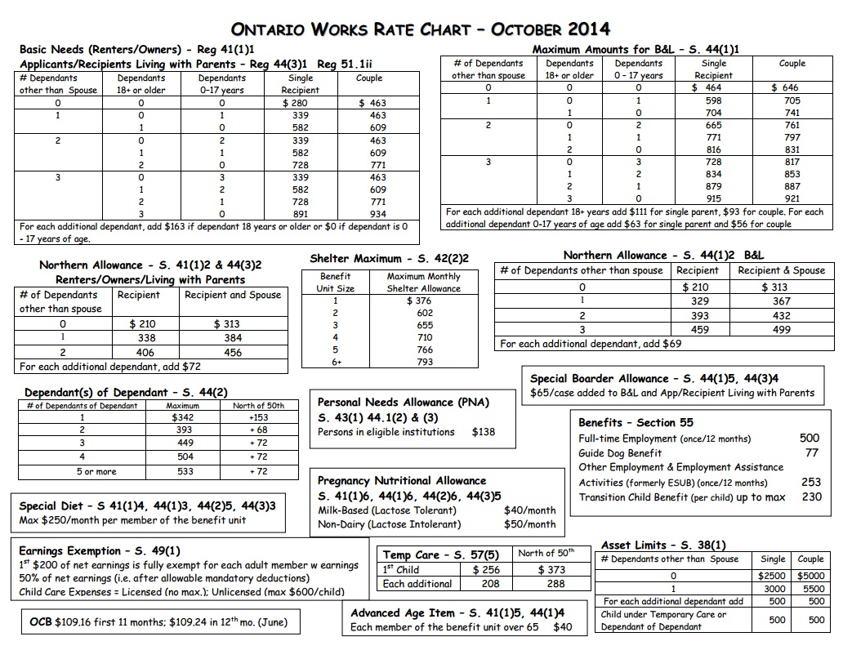
Entitlements to be replaced 1 October 2014

Slide 13

Pregnancy & Breastfeeding
Client is provided with an Application for Pregnancy or Breastfeeding Nutrition Allowance Form.
This form is to be completed by an approved health professional.
Note: Breastfeeding – verbal confirmation from the mother that she is nursing is required.

Slide 14

Special Diet
Clients with dietary needs will be given a Special Diet Form.
Medical forms must be completed by an approved health professional:
  A Physician registered with the College of Physicians and Surgeons of Ontario
  A Registered Nurse in the extended class Registered with the College of Nurses of Ontario
  A Registered Dietician registered with the College of Dieticians of Ontario
  A Registered Midwife registered with the College of Midwives of Ontario

Slide 15
Benefits
Mandatory Benefits
provided to all eligible Ontario Works recipients and/or members of their benefit unit.
Discretionary Benefits (NEW POLICY)
provided on a case-by-case basis at the discretion of the Administrator
dollar amount is determined by the Administrator.

Slide 16
Mandatory Benefits
Health-Related benefits:
  prescription drug coverage
  dental and vision care for dependent children and children in temporary care
  diabetic supplies, surgical supplies and dressings
  medical transportation costs $15 and over
  consumer contribution for assistive devices and eligibility assessment under the Assistive Devices Program (ADP)
  batteries and necessary repairs for mobility devices
  routine eye examinations once every 24 months (ages 20-64)
  extended health benefits
Guide Dog Benefit
Full-time Employment Benefit
Other Employment and Employment Assistance Activities Benefit
Advance (up front) child care
Transition Child Benefit

Slide 17
Discretionary Benefits (NEW POLICY)
  Health Related – Capped 1 April 2013
    Dental and vision care for adults
    Prosthetic appliances
    Child care to attend a medical appointments
    Funerals & burials ($2500 per funeral)
  Non – Health Related – Capped 1 April 2013
    Vocational training
    Travel and transportation that is not for health – related purposes
    Heating payments and payments for low – cost heating energy conservation measures
    Any other special service, item or payment authorized by the Director
    Note: Changes to Dental anticipated

Slide 18
  FIRST NATION TRANSITIONAL SUPPORT FUND (TSF)
  Capped 1 April 2013
  Replaces the Community Start Up and Maintenance Benefit (CSUMB).
The First Nation Transitional Support Fund (TSF) is designed to provide housing related supports to social assistance recipients to secure, retain and/or maintain accommodation.
The TSF may be issued for the following purposes:
Deposits relating to shelter costs such as hydro, fuel (heating), utilities or rent.
Arrears to prevent the disconnection or disruption of service for hydro, utilities or heat
Any other housing related services, items or costs that are needed as authorized by the Administrator
Note: Administrator may issue overpayment on client file when client’s payment history reflects non-payment during months of employment.

Slide 19

Overpayments
Overpayments are established when:
  You receive benefits that you are not entitled to
  You fail to honour an assignment to reimburse
  You fail to report any/all income
  Calculations of entitlements are incorrect, with the exception of the TCB
On active cases, recovery of overpayments are calculated as a 5% deduction of monthly assistance unless the recovery would create hardship for the recipient.

Slide 20
Employment Assistance
Employment Information Sessions
Participation Agreements
Planned Activities
Non-Compliance & Reasonableness Test

Slide 21
Employment Information Sessions
All adults included in benefit units are required to attend an Employment Information Session.
Administrators have the discretion to schedule the information sessions as:
  Group sessions where practical
  Part of the application process
  Initial activity of the Participation Agreement

Slide 22
Eligibility Requirements
Participants are required to sign a Participation Agreement that defines how they will participate in employment assistance activities, as well; seek, accept and maintain employment
Clients identify a plan of activities they would like to participate in
Eligibility for assistance depends on the clients fulfilling participation requirements as outlined in the Participation Agreement

Slide 23
Participation Agreements (PA)
Required for all adult members of the Benefit Unit
Spouses and dependent adults of an ODSP Benefit Unit may also be referred (by ODSP) to the Ontario Works office to complete a PA and participate in employment assistance activities
PAs are a plan of action created by the client with guidance from the OW staff member

Slide 24
Exempt from Participation Requirements
Individuals applying for, or in receipt of, Temporary Care Assistance (TCA) on behalf of a child, and who is not in receipt of assistance themselves;
Individuals receiving interim assistance while appealing an eligibility decision; and
Individuals receiving Extended Health Benefits (EHB)

Slide 25
PA’s Offer Three Categories
Temporary Deferral
Restrictions on Participation
Planned Activities
  By signing the Participation Agreement, the participants agree to the plan that has been negotiated with the caseworker
  PA’s are updated every 3 months or sooner if client starts employment, changes and starts an activity

Slide 26
Temporary Deferral
The requirement to participate may be temporarily deferred for:
    A sole support parent with at least one dependent child for whom publicly funded education is not available;
    A participant who is a caregiver for a family member with a disability, illness or old age;
    A participant who is 65 years of age or older;
    Other exceptional circumstances approved by the Administrator (i.e.: awaiting ODSP, victim of family violence
PAs are still completed identifying the reasons for temporary deferral as well as bring forward date where the deferral will be reviewed
The temporary deferral is deferred for three months and then assessed based on the reason and circumstances of the deferral

Slide 27
Restrictions on Participation
Restrictions may include:
Physical limitations and/or medical conditions
Personal circumstances and/or family emergencies
Present a danger to the health and well being of the client
Interferes with personal or religious beliefs
Acceptable forms of documentation to support the restriction include:
Letter from a qualified health professional
Completed limitations to participate form
Letter from religious leader stating restrictions
Any other acceptable form as determined by the Administrator

Slide 28
Planned Activities
Early Employment Supports / Activities and Basic Education – Personal Development Series supported by PARO, ILC, and YES Employment
Literacy Screening, Assessment and Training
Learning, Earning and Parenting (LEAP)
Addiction Services Initiative (ASI)
Employment Placements
Community Placements – Community Development
Child Care Supports

Slide 29
Employment Resource Centre Services
Ontario Works sites provide clients with access to services through:
On–site resource centre or referral to other agencies that do provide services.
Information on available employment supports and local labour market
Inventory of available community supports such as:
    Training, Literacy and Basic Education
    Counselling services, addiction services, child care
    Available community placements,
    Equipment to support job searches (telephone, internet, computer), workshops on job strategies, job boards, job banks and referrals to employment opportunities

Slide 30


Basic Education
Referrals
  Enrolment into Adult Education programs that work towards grade 12 or equivalency
  Literacy programs that improve language and literacy
Educational programs must support progress towards employment or employability

Slide 31
Literacy Screening Questionnaire (LSQ)
All applicants and participants with less than a Grade 12 or equivalent education are required to take the LSQ unless confirmation of a learning disorder can be provided
Any participant can be required to take the LSQ regardless of their education if literacy is a barrier to securing and maintaining employment
Applicants who refuse to take the LSQ are ineligible for social assistance.
If a participant refuses to take the LSQ or participate in literacy assessment and/or training and they do not have proof of a learning disorder, then the Ontario Works policy on noncompliance is applied

Slide 32
Job Specific Skills Training
Participants can access MCTU funded programs independently or by referral by the Ontario Works office.
Attendance and progress are monitored and expected results are recorded in client case file.
Participants who are interested in long term education/training will be referred to First Nation education authority or other appropriate resources such as local ARDA’s

Slide 33
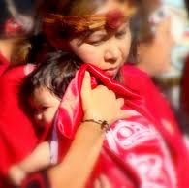
LEAP: Learning, Earning and Parent & Child Development
  LEARNING
    Requires participants to attend educational programs that lead towards grade 12. Regular attendance is required in an approved program
  EARNING
    LEAP participants have access to employment supports and resources
  PARENT & CHILD DEVELOPMENT
    A minimum of 35 hours of participation in an approved parenting program is required for LEAP participants

Slide 34

LEAP is mandatory for all 16 & 17 year old parents who do not have their high school diploma/equivalency receiving financial assistance
LEAP is voluntary for participants aged 18 – 25 who have not completed high school
A $500 bursary (RESP) is provided to each participant who successfully completes LEAP requirements. Bursary can be applied for post secondary education for the participant or the participant’s child. May be split between dependents.

Slide 35
Leap Cont’d
Individual Service Plans (ISP) are created for each participant and identify how the participant will meet each component of LEAP. The ISP is developed collectively with the participant and the worker to ensure the clients needs and program requirements are met.
ISP’s must identify:
  Participation in each LEAP component
  Roles and Responsibilities
  Identifies other service providers.

Slide 36


Addiction Referral
Participants who identify addictions as a barrier to employment should be referred to community services to address the addiction barriers
Participants may be referred to other First Nation programs providing appropriate and adequate services (NNADAP)
Documentation confirming participant attendance in programs will be kept on file
Monitoring and follow – up will occur

Slide 37


Community Placements
Unpaid community development services that provide participants with experience and skills that increase employability
  Community development services will be provided to clients who are interested and exploring various career opportunities
  Supports and resources required to complete the placement
  OW is responsible for any out of pocket expenses the participant may accumulate during placements

Slide 38
Guidelines
Participants must be covered by WSIB or private accidental insurance
No more that 70 hours a month will be spent on all approved placements
Maximum of 8 hours a day and 44 hours in one week is allowed for one placement
Participants may spend a maximum of 6 months at a placement unless training is provided. If training is provided, placements must not exceed more that 12 months

Slide 39
Employment & Participation Benefits
Full-Time Employment Benefit (FTEB)
Employment Related Expenses (ERE)
  Other Employment and Employment Assistance Activities Benefit (OEEAAB)
  Note: Anticipated changes April 2015

Slide 40
Full–Time Employment Benefit (FTEB)
Is available to each recipient, spouse included in the benefit unit or dependent adult to help with expenses associated with beginning full–time employment
Eligibility Requirements
To qualify for the benefit, recipients must:
Must have been on social assistance for three consecutive months
Beginning full–time employment (30+ hours a week) and requires assistance costs of going to work

Slide 41
Employment Related Expenses (ERE)
Provided to support participants as they progress forward toward employment
Also available for ODSP recipients who are participating in Ontario Works employment assistance activities
When someone is eligible for the Other Employment and Employment Activities Benefit, that benefit is accessed first

Slide 42
ERE payments may cover out – of – pocket expenses associated with participation in employment assistance activities, including:
Necessary transportation
Clothing / protective clothing, grooming, supplies / special equipment and telephone expenses
Criminal reference checks or medical examinations and certificates (where required as a condition of job referral or community placements)
Costs associated with obtaining a Pardon (for the removal of a criminal record) where the criminal record may be a barrier to employment
Minor fees (e.g.: certification charges, short training costs) and licensing fees
Child care costs to make participation in employment possible
Any other cost the administrator considers necessary and reasonable, such as a meal allowance

Slide 43
  Other Employment And Employment Assistance Activities Benefit (OEEAAB)
    Can be provided to each recipient, spouse in the benefit unit, dependent adult not attending school full–time or a training program, or dependent child who has graduated from secondary school.
    Maximum amount that can be provided to each eligible recipient is $253 in a 12 month period
    Provided to assist with costs associate with beginning or changing employment or an employment assistance activity.
      Costs such as: appropriate work wear, grooming costs, licensing fees, association costs, tools and equipment, transportation costs, any other support required as authorized by the Administrator
    Eligibility Requirements
      Beginning or changing participation in employment assistance activities; or
      Beginning or changing part–time employment with a current or new employer where the duties and responsibilities are substantially different that the previous job
      Self Employed participants may access this benefit if costs are associated with the initial start – up of the business

Slide 44
Child Care Supports
Clients participating in employment assistance activities are eligible for support with child care costs from these two types of childcare:
  Formal
    Licensed childcare, daycare costs based on actual costs
  Informal
    Costs for babysitters or alternative child care (summer camp, supervised programs, and homework programs) up to $600 can be provided per child
Payments for informal child care cannot be paid to:
A person who has a legal obligation to care for the child
A sibling who is under the age of 18 who resides with the recipient
Dependent adult who is part of the benefit unit

Slide 45
ADVANCE (UP FRONT) CHILD CARE PAYMENT
an advance (up front) child care payment may be provided to a recipient,
a spouse included in the benefit unit, a dependent adult or a dependent
child with a dependent child if in the opinion of the Administrator the person is required to pay in advance for child care that is necessary to permit employment or an employment assistance activity.

Slide 46
Ineligibility for Non-Compliance
By signing the PA, applicants and participants agree to the plan that has been negotiated with the caseworker and acknowledge their understanding of the consequences for refusing to participate or failing to make reasonable efforts to participate in activities outlined in the agreement.
Four types of non–compliance with participation requirements:
Refusal to accept employment and make reasonable efforts to maintain employment
Refusal to accept a referral for participation in an employment assistance activity without reasonable cause
Refusal to accept an offer of a placement without reasonable cause
Failure to meet reasonable efforts to meet participation requirements without reasonable excuse

Slide 47
Reduction of assistance
Reduction of assistance shall reflect the basic needs and shelter amounts and benefits for the non compliant individual
Assets and income of the non compliant individual are still calculated and applied to the benefit unit
If the client relocates to another Ontario Works site, the period of ineligibility remains applicable
An internal review can be requested by the client for decisions of ineligibility or reduction of assistance, and may be appealed to the Social Benefits Tribunal
Written communication will be provided to the client and a copy f the letter inserted into the clients file

Slide 48
Reasonableness Test
Clients should be provided the opportunity to provide information to support whether non-compliance is a result of an employment barrier or a situation beyond their control which could include:
  Temporary illness
  Absence of appropriate child care
  Court appearance or detainment
  Change or shift in client personal needs & individual circumstances
  Inappropriate “fit” for the participant
  Program resources and services to support employability not available
  Failure of transportation arrangements and no alternative
  Extreme inclement weather that affects mobility

Slide 49
Reinstatement of Eligibility
Recipients whose assistance is cancelled or reduced due to non compliance are required to reapply for assistance or request reinstatement once they are done serving their penalty period and must meet participation requirements in order to re–qualify
A new Participation Agreement is signed
If the client fails to comply with program requirements for an extended period of time, the amount of assistance for the non compliant individual is removed from the budget unit entitlements
If the client chooses to comply with requirements at the end of the ineligibility period, the individual’s share of the benefit unit is restored

Slide 50




Friends of Social Services Department

Slide 51
Ganawend'Zoyang
“taking care of our own”
Social Services Department
Questions
Concerns

